Slide 1
Section 12.1
Systems of Linear Equations;
Substitution and Elimination
Copyright © 2012 Pearson Education, Inc. Publishing as Prentice Hall.

Slide 2



A movie theater sells tickets for $8.00 each, with seniors receiving a discount of $2.00. One evening the theater took in $3580 in revenue. If x represents the number of tickets sold at $8.00 and y the number of tickets sold at the discounted price of $6.00, write an equation that relates these variables.
Suppose we also know that 525 tickets were sold. Write another equation relating the variables x and y.
Copyright © 2012 Pearson Education, Inc. Publishing as Prentice Hall.

Slide 3
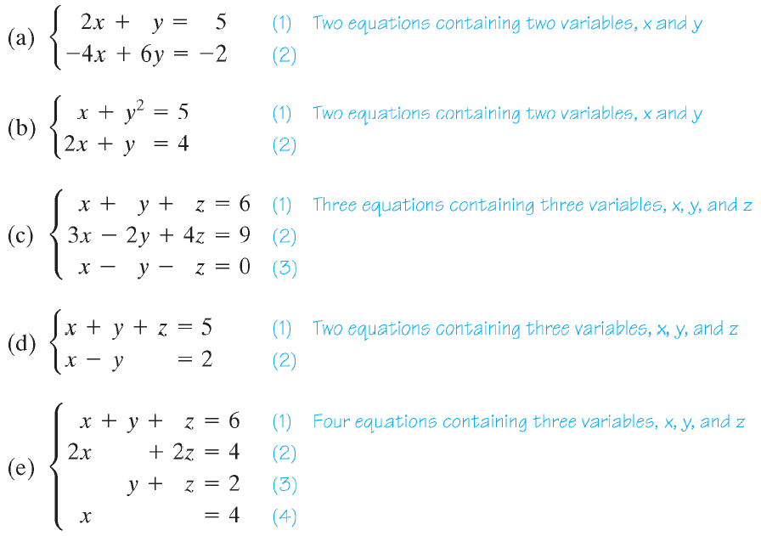
Copyright © 2012 Pearson Education, Inc. Publishing as Prentice Hall.

Slide 4
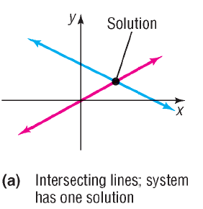
Copyright © 2012 Pearson Education, Inc. Publishing as Prentice Hall.

Slide 5
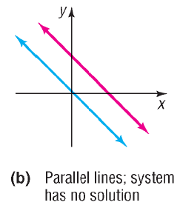
Copyright © 2012 Pearson Education, Inc. Publishing as Prentice Hall.

Slide 6
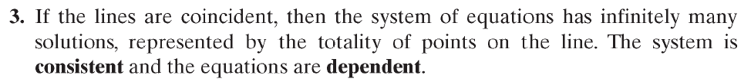
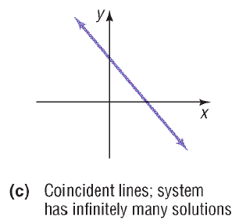
Copyright © 2012 Pearson Education, Inc. Publishing as Prentice Hall.

Slide 7
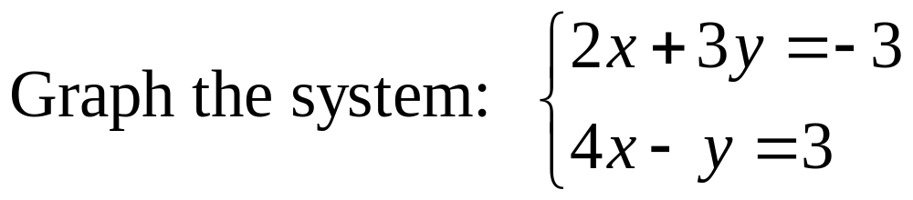
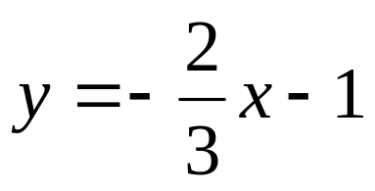
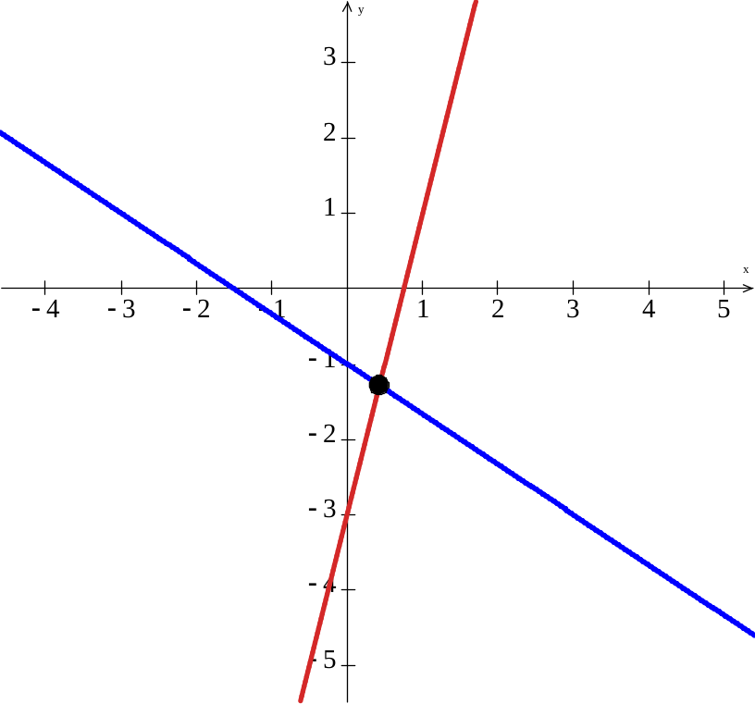
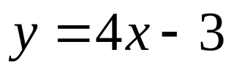
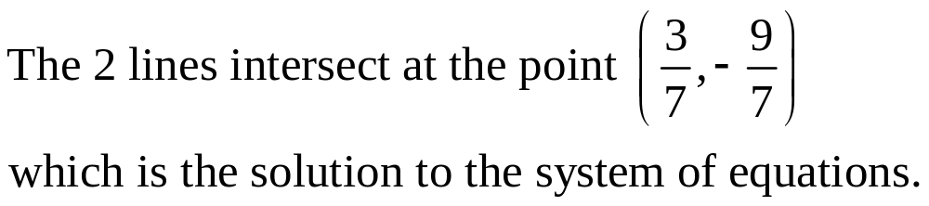
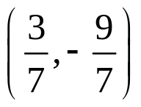
Copyright © 2012 Pearson Education, Inc. Publishing as Prentice Hall.

Slide 8
Copyright © 2012 Pearson Education, Inc. Publishing as Prentice Hall.

Slide 9
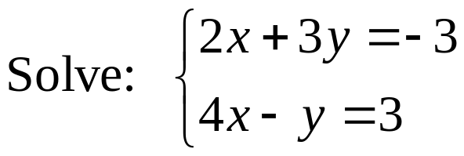

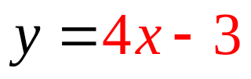

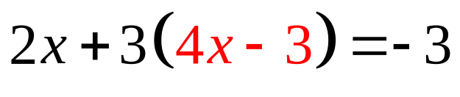
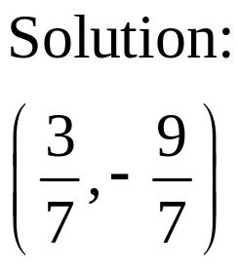
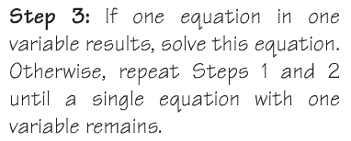

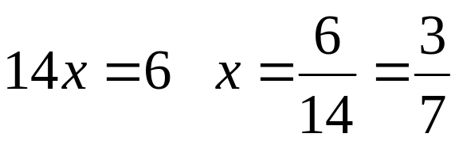
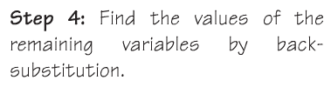
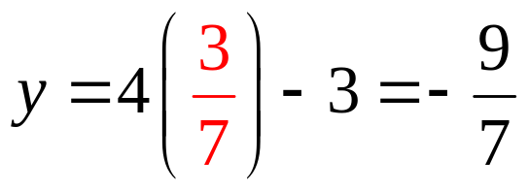
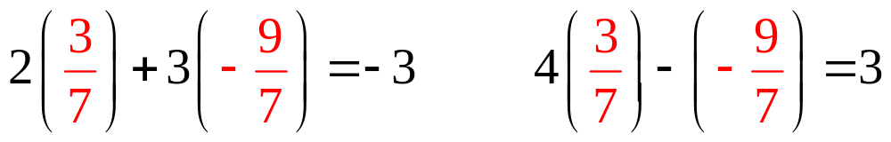

Copyright © 2012 Pearson Education, Inc. Publishing as Prentice Hall.

Slide 10
Copyright © 2012 Pearson Education, Inc. Publishing as Prentice Hall.

Slide 11
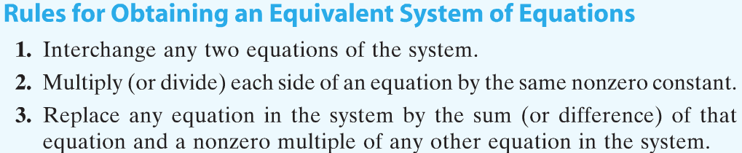
Copyright © 2012 Pearson Education, Inc. Publishing as Prentice Hall.

Slide 12
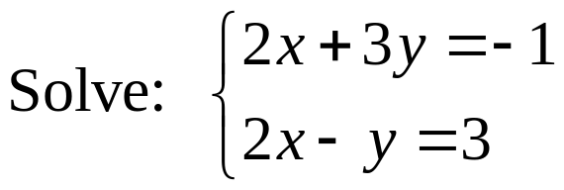
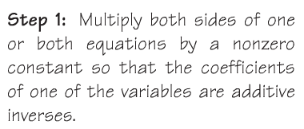
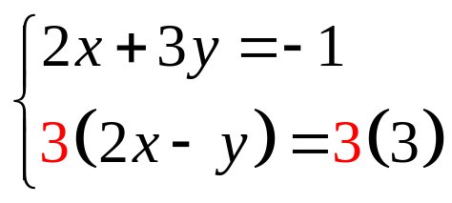
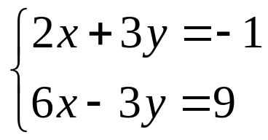
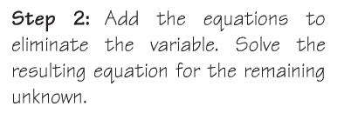
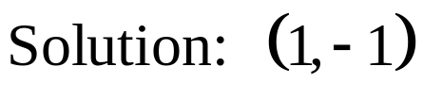

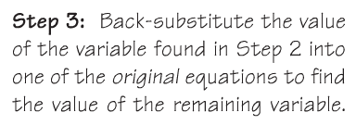

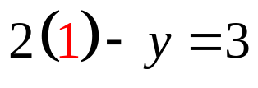


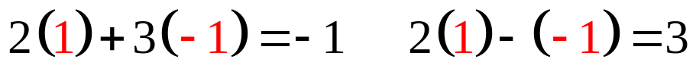
Copyright © 2012 Pearson Education, Inc. Publishing as Prentice Hall.

Slide 13
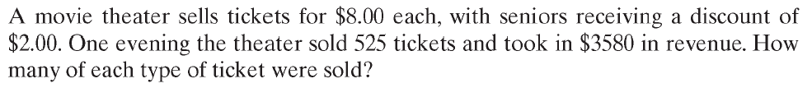


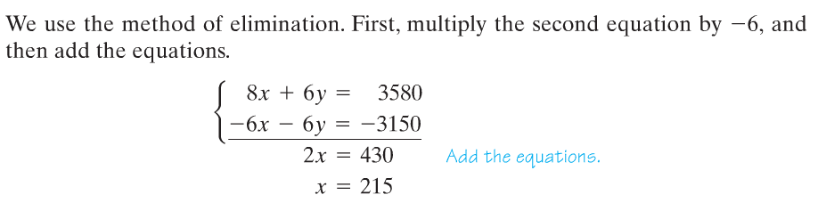
Copyright © 2012 Pearson Education, Inc. Publishing as Prentice Hall.

Slide 14
Copyright © 2012 Pearson Education, Inc. Publishing as Prentice Hall.

Slide 15
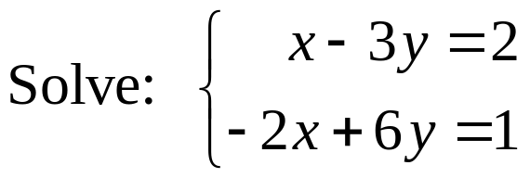
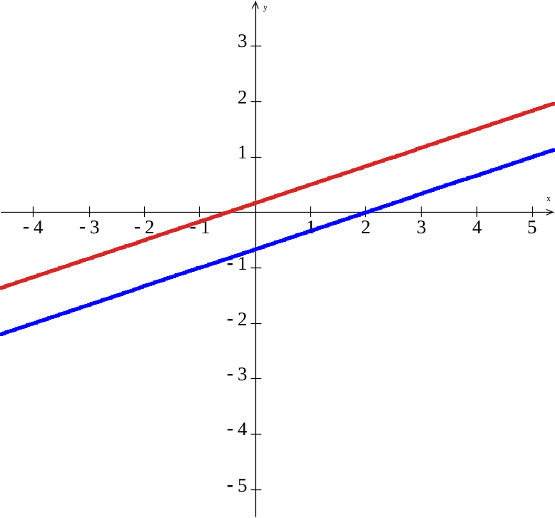


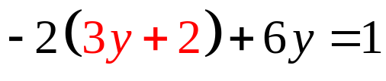


Since this statement is false we conclude there is no solution. We say the system is inconsistent.
Copyright © 2012 Pearson Education, Inc. Publishing as Prentice Hall.

Slide 16
Copyright © 2012 Pearson Education, Inc. Publishing as Prentice Hall.

Slide 17
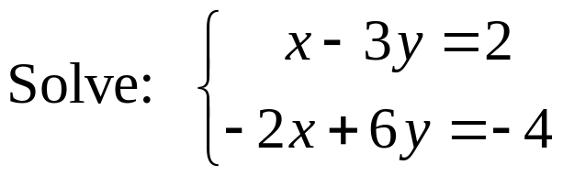
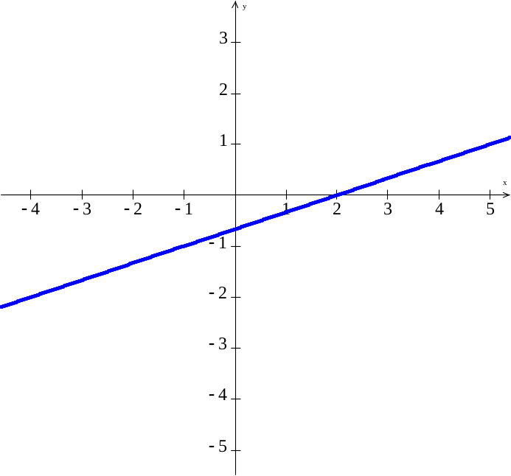

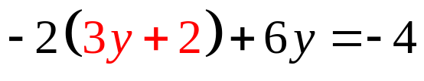


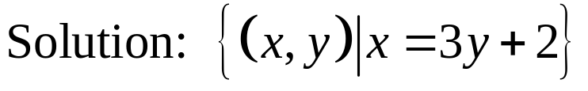
Since this statement is true but we have no variables, the two equations are equivalent so the equations are dependent.
Copyright © 2012 Pearson Education, Inc. Publishing as Prentice Hall.

Slide 18
Copyright © 2012 Pearson Education, Inc. Publishing as Prentice Hall.

Slide 19
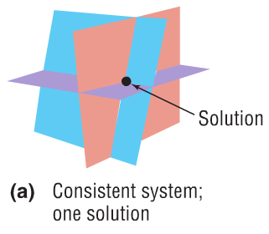
Copyright © 2012 Pearson Education, Inc. Publishing as Prentice Hall.

Slide 20
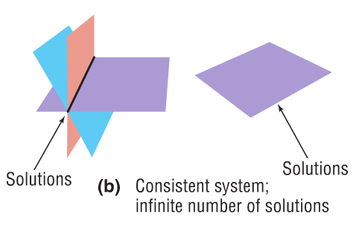
Copyright © 2012 Pearson Education, Inc. Publishing as Prentice Hall.

Slide 21
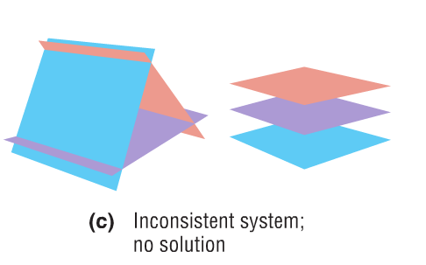
Copyright © 2012 Pearson Education, Inc. Publishing as Prentice Hall.

Slide 22
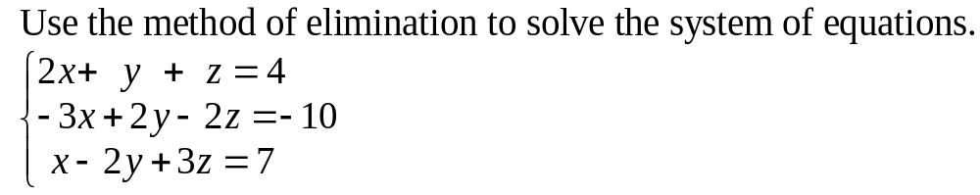
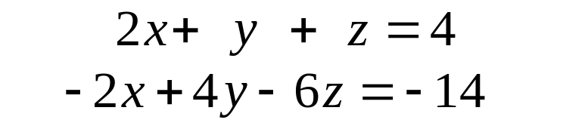
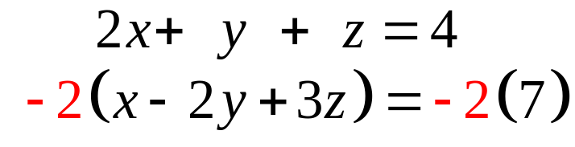

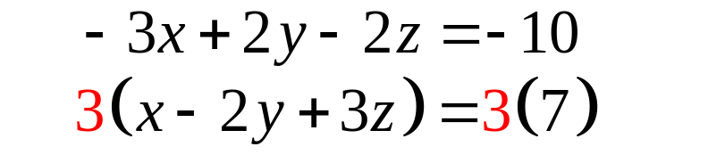
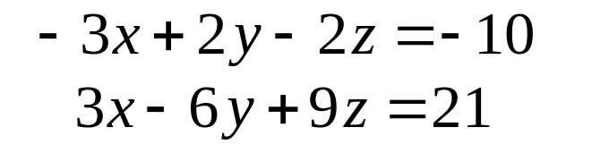
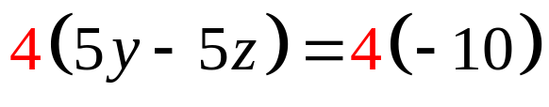


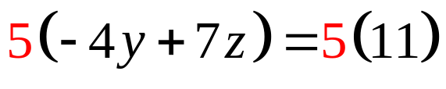



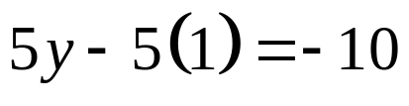




Copyright © 2012 Pearson Education, Inc. Publishing as Prentice Hall.

Slide 23

Copyright © 2012 Pearson Education, Inc. Publishing as Prentice Hall.

Slide 24










Since this statement is false we conclude there is no solution. We say the system is inconsistent.
Copyright © 2012 Pearson Education, Inc. Publishing as Prentice Hall.

Slide 25
Copyright © 2012 Pearson Education, Inc. Publishing as Prentice Hall.

Slide 26









Since this statement is true but we have no variables, the equations are dependent.
Copyright © 2012 Pearson Education, Inc. Publishing as Prentice Hall.

Slide 27














Copyright © 2012 Pearson Education, Inc. Publishing as Prentice Hall.

